Slide 1
LOST & FOUND MANAGEMENT SYSTEM
A lightweight Django web app for reporting, tracking, and resolving lost and found items
TEAM MEMBERS
Kushal Maharjan
Nhuza Maharjan
Arpita Katuwal
Rohina Tandukar
Project Presentation · August 2026

Slide 2

THE PROBLEM
Lost items rarely find their way back
1
2
3
No searchable record
Inconsistent status
No remote visibility
Reports live in chats, posters, and word of mouth — then vanish.
The same item gets "found" twice, or is never marked claimed.
You must physically visit a desk to check if your item turned up.
Lost & Found Management System

Slide 3
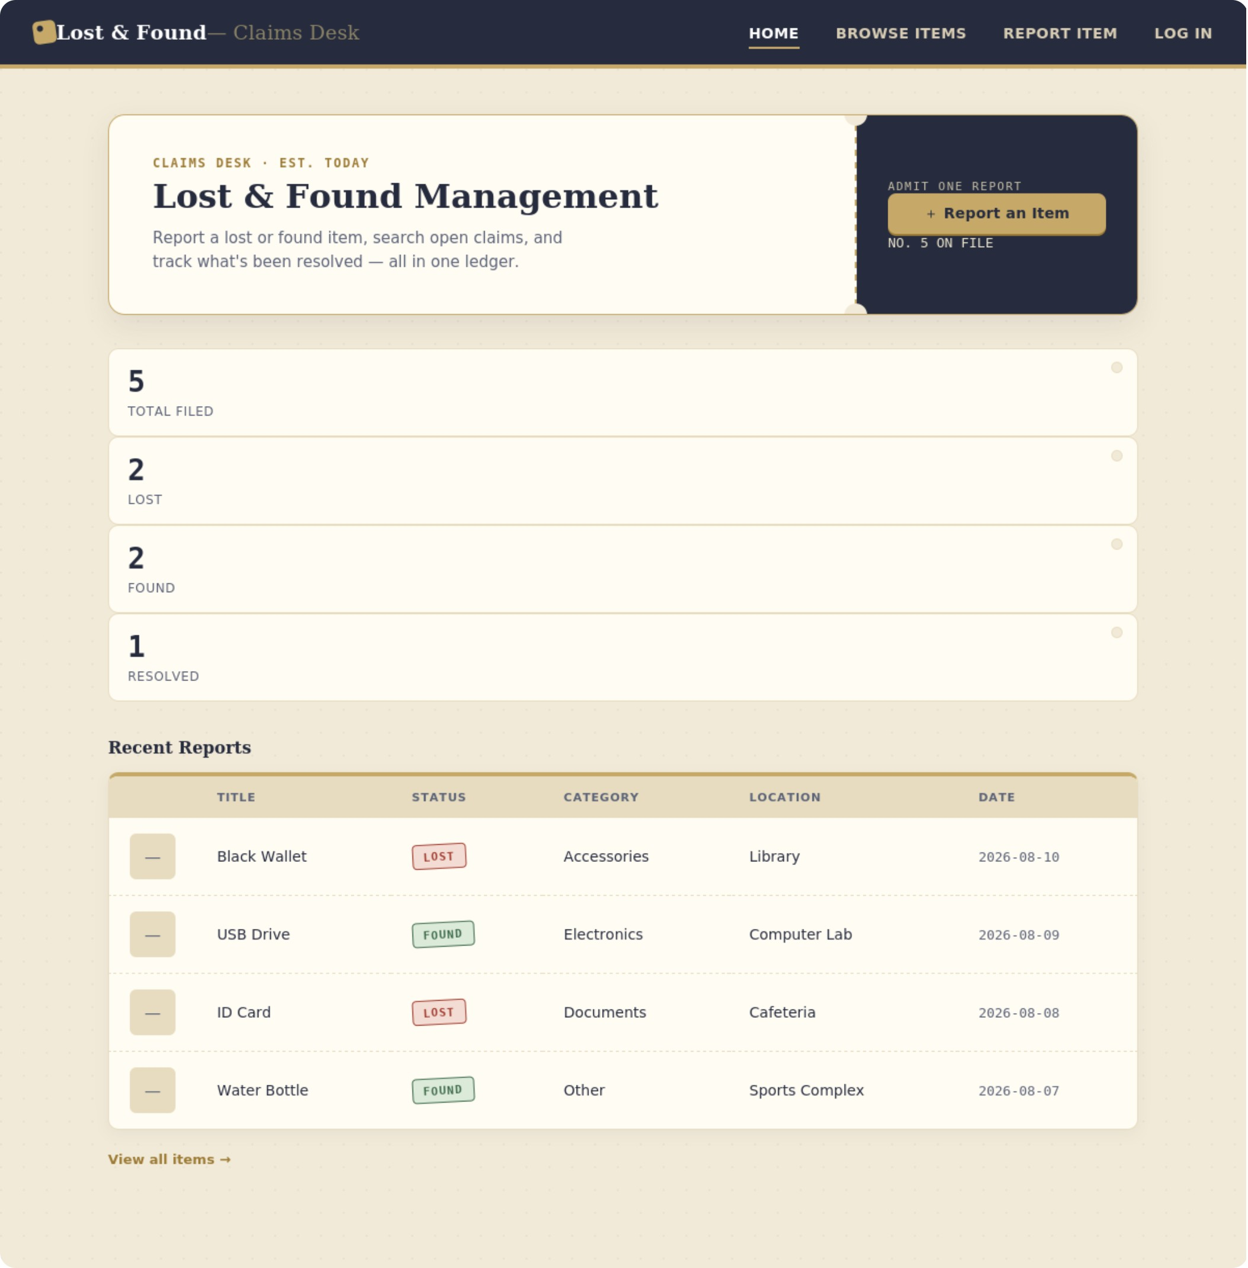
THE SOLUTION
One shared, always-on ledger
A lightweight Django web app gives the whole campus a single place to report, search, and resolve lost and found items — no database server, no accounts, just a transparent CSV/JSON ledger anyone can trust.
Report in seconds
Search & filter instantly
Admin-gated edits
Photo evidence built in
Live home dashboard — real counts, pulled straight from the CSV
Lost & Found Management System

Slide 4

MAIN FEATURES
Everything a claims desk needs
1
2
Report an Item
Browse & Search
Open form, optional photo, no login required.
Filter by title, location, or status — shareable via URL.
3
4
Admin Edit / Resolve
Delete with Confirm
Correct details or mark an item Resolved, cookie-gated.
Removes the record and its photo, guarded by a prompt.
5
6
Live Dashboard
Secure Admin Login
Total / Lost / Found / Resolved counts on every load.
Signed, expiring cookie — no full auth system needed.
Lost & Found Management System

Slide 5






HOW IT WORKS
From browser click to saved record
Browser
URL Router
View Logic
User submits a form or search query
Django dispatches to the matching view
Validates input, checks admin cookie
CSV / JSON
Template
Record read from or written to disk
HTML rendered back to the browser
Every write (report, edit, delete) rewrites the CSV and re-syncs the JSON mirror in the same request — no background jobs, no queues.
Zero background jobs
Reads and writes finish inside the same request

Slide 6
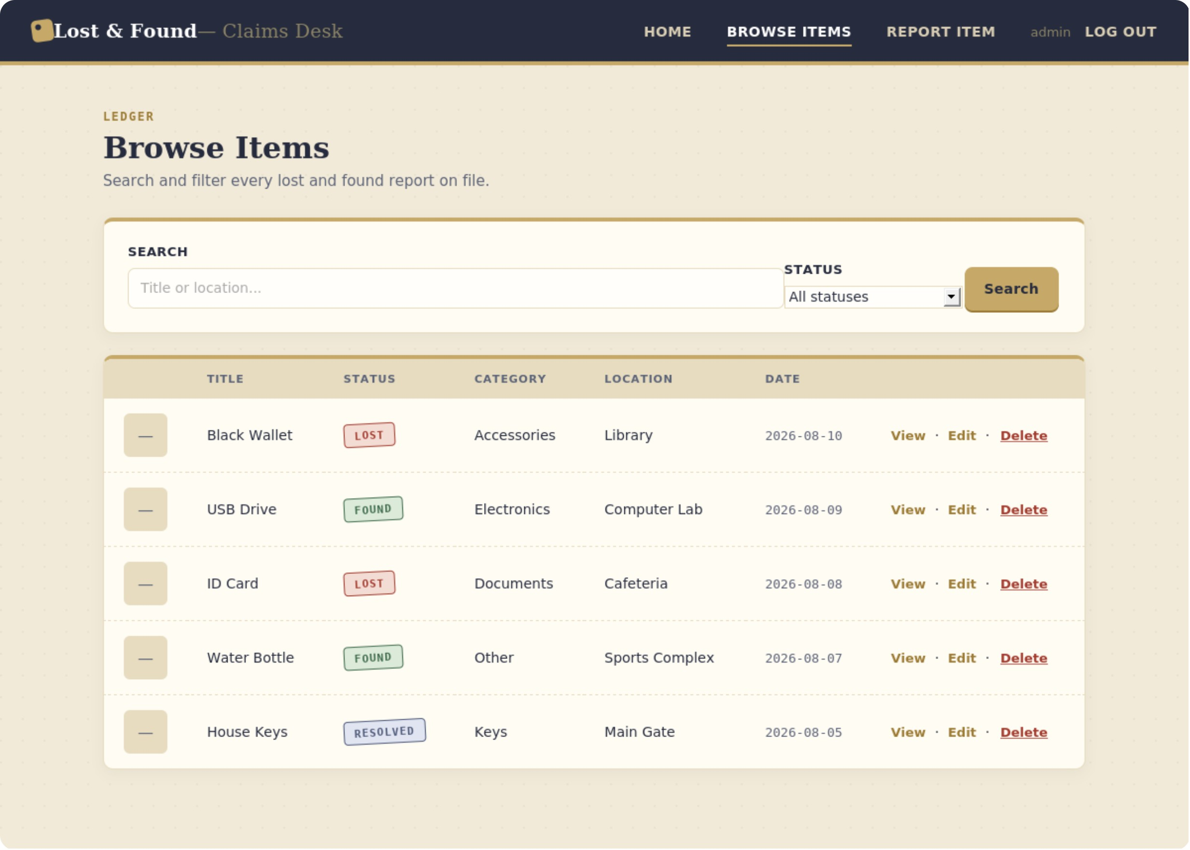
DEMO
Browse, search, and manage in one view
Combined search box — matches title or location
Status dropdown filters Lost / Found / Resolved
Admin sees View · Edit · Delete on every row
Results are shareable via the URL's query string
Lost & Found Management System

Slide 7
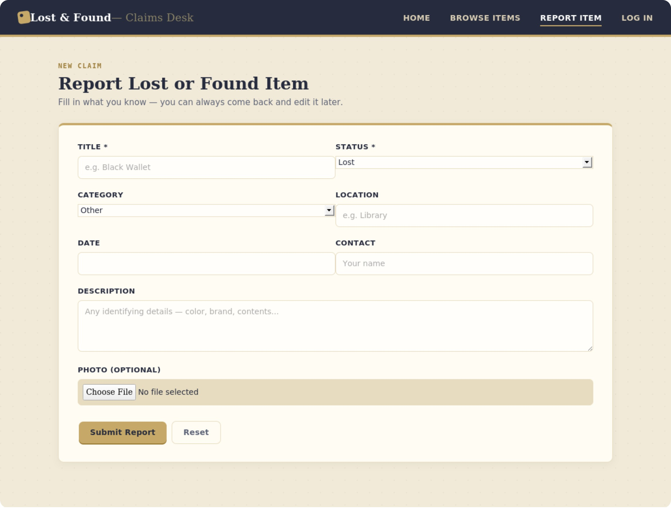
DEMO
Reporting an item takes seconds
Open to anyone — no login required to report
Optional photo upload for identification
Title, category, location, date, contact fields
Saved straight to CSV, mirrored to JSON
Lost & Found Management System

Slide 8
TECHNOLOGIES
Doesn't rely on too many extra add-ons.
Python 3.12
Django 6.1
Core language — csv, json, os, datetime from the standard library
Routing, templates, CSRF protection, dev server
django.core.signing
CSV + JSON
Signed, tamper-proof admin session cookie
Human-readable storage, no database server required
SQLite (reserved)
HTML5 / CSS3
Bundled with Django, ready for future migration
One embedded stylesheet, no build step
Lost & Found Management System

Slide 9
RESULTS
Verified across every core user flow
19
8
manual test cases — all passing
core fields per item record
0
6
external services or paid APIs
CRUD & auth routes covered
Configuration check (python manage.py check) reported zero errors before manual testing began.
CRUD flows: report → search → edit → resolve → delete
Access control: edit/delete blocked when signed out
Edge cases: invalid item IDs, missing fields, open-redirect protection
Lost & Found Management System

Slide 10
CONCLUSION
Simple, transparent, and it just works
The Lost & Found Management System proves a campus community doesn't need a heavy database or account system to solve a real coordination problem — just a clear lifecycle, an honest ledger, and a little bit of Django.
Next up: ORM migration, automated tests, and smarter LOST/FOUND matching.

Slide 11
THANK YOU

